Slide 1
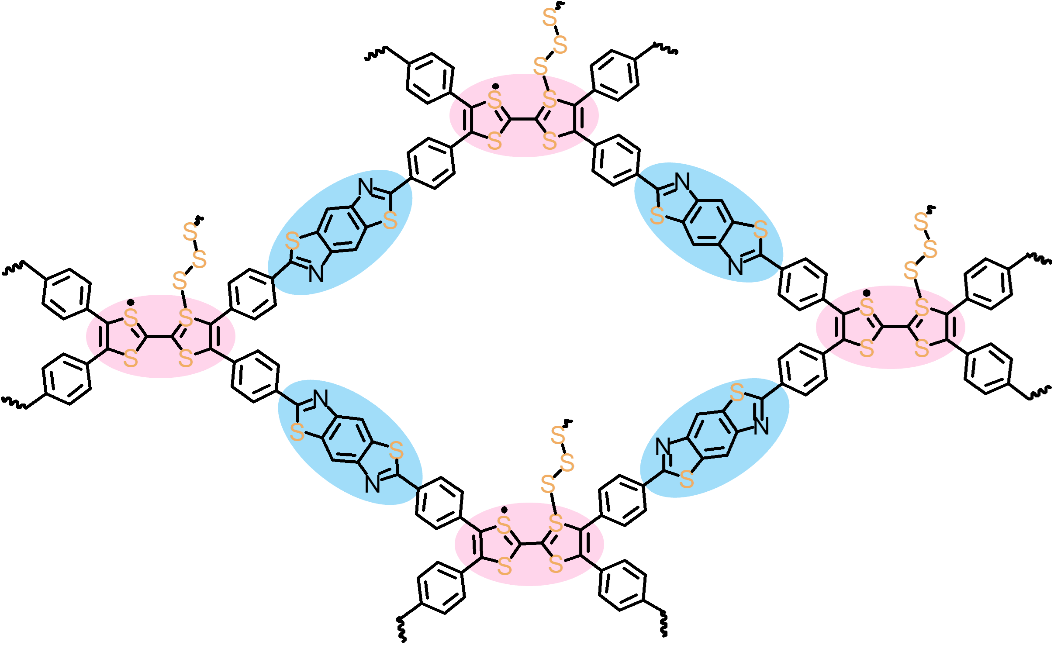
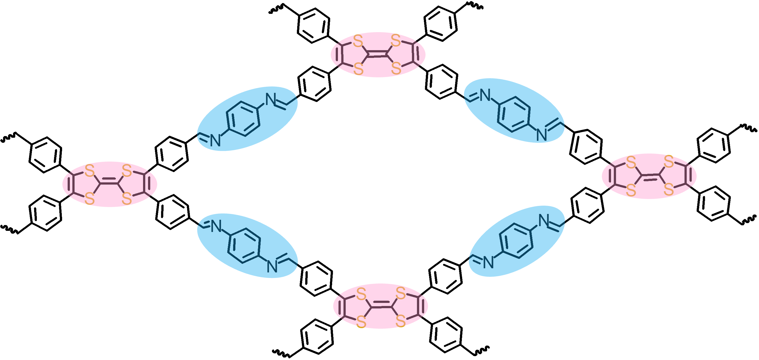
TTF-COF
SCOF (Sulfurized TTF-COF)
Sulfurization 360 degree

